Slide 1
Panamericana Texana
Publications Committee
Aug 17, 2024

Slide 2
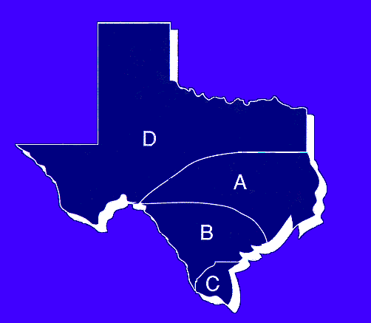
B- Beeville
B-Corpus Christi
B- Del Rio
B-Eagle Pass
B- Laredo
B- San Antonio
TEXANA -Editor
Raquel Oliva, Chairperson
C-McAllen
roliva39@gmail.com
A- Austin
A-Conroe
A- Houston (2)
D-Dallas III
D-El Paso
D- Fort Worth
Mitzi Patiño Eastman
A-Austin
pmmteast@gmail.com
Gloria Riddle
A-Conroe
deglorious@gmail.com
Lucy Mancha
B-Eagle Pass
lucymancha16@hotmail.com
B Karen Salim
B-Corpus Christi
kselim@cbcfoundation.org
C-Alamo-San Juan-Pharr
C-Brownsville I
C-Edinburg
C-McAllen
C-Rio Grande City/Roma
Dee Cavazos
C-Rio Grande City-Roma
deecavazos@ymail.com

Slide 3


Publications Committee
Things to do
  Ask the Table Director to assign someone to provide photos and information for the Texana.
    Keep everyone informed. Emails should go to the Table Director, Table ECC, and Table Historian.
  Ask them to take photos at all meetings.
  Send your reminders and requests for information to more than the Table Director. Sometimes, they forget to forward your email.

Slide 4
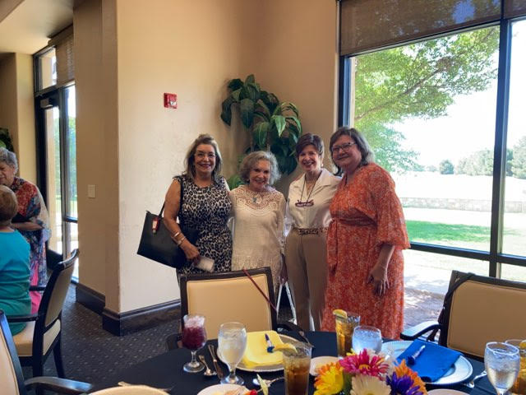
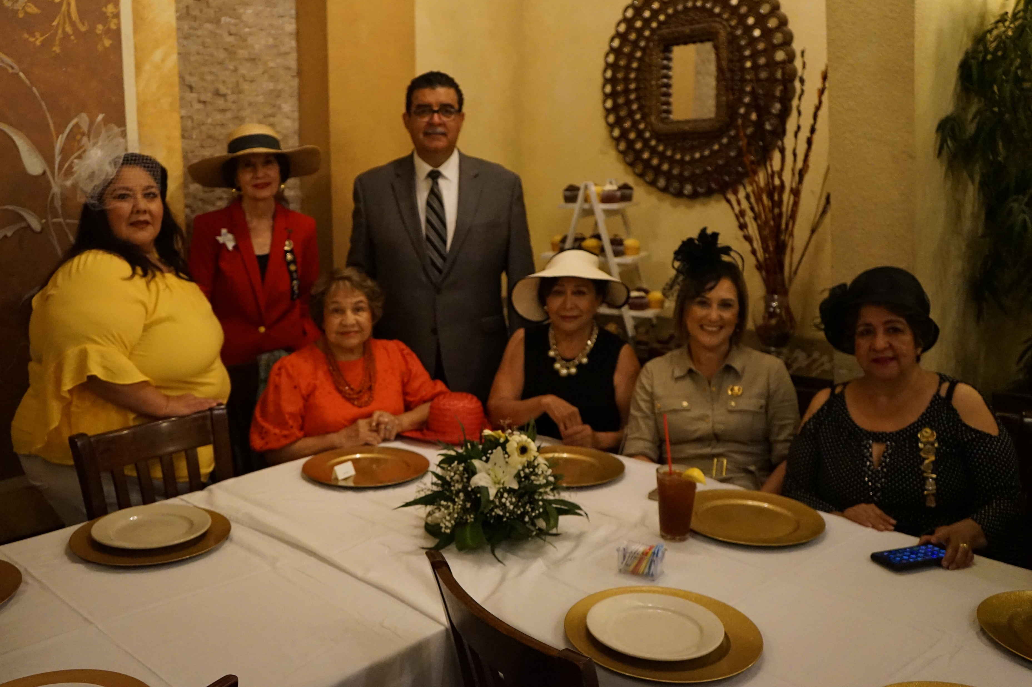
What to Ask For
Do not stretch photos.
Photo.
You may need to give hints on how to take better photos. Screen for photos that are not of good quality for printing.
Short description of activity, month, type of meeting, or event event
People, list Left to Right, bottom row first. If it is a large group, leave names off.
Too far away. Need to crop
Too Dark

Slide 5
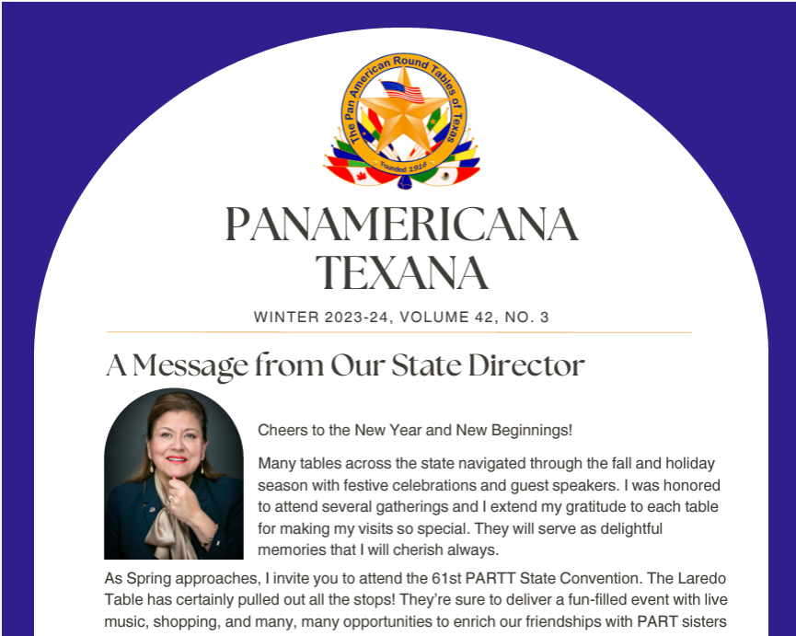
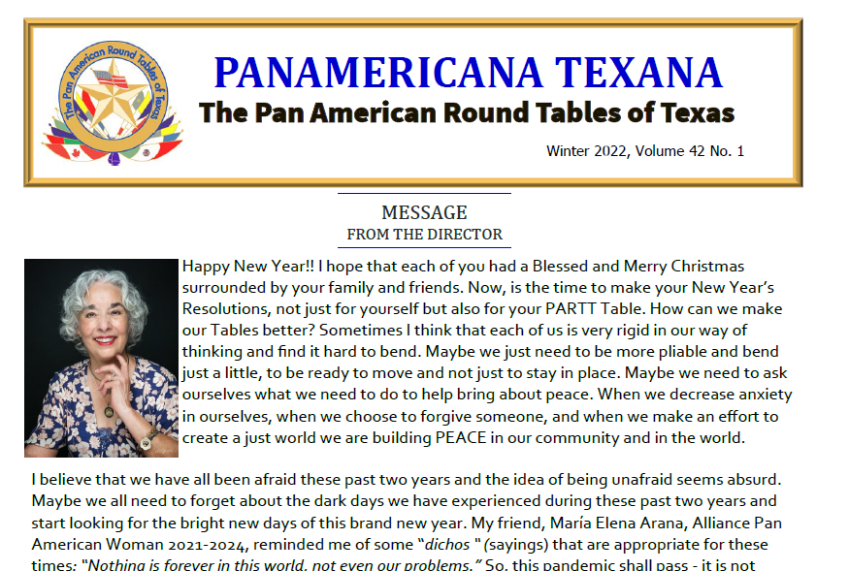
Cover: Message from State Director

Slide 6
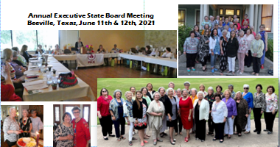
Inside Cover: State News
Officers
August Executive
State Board meeting
State Directors visit to
Tables

Slide 7
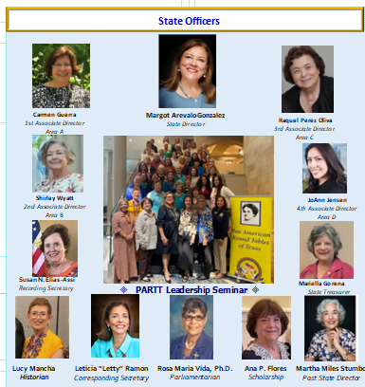
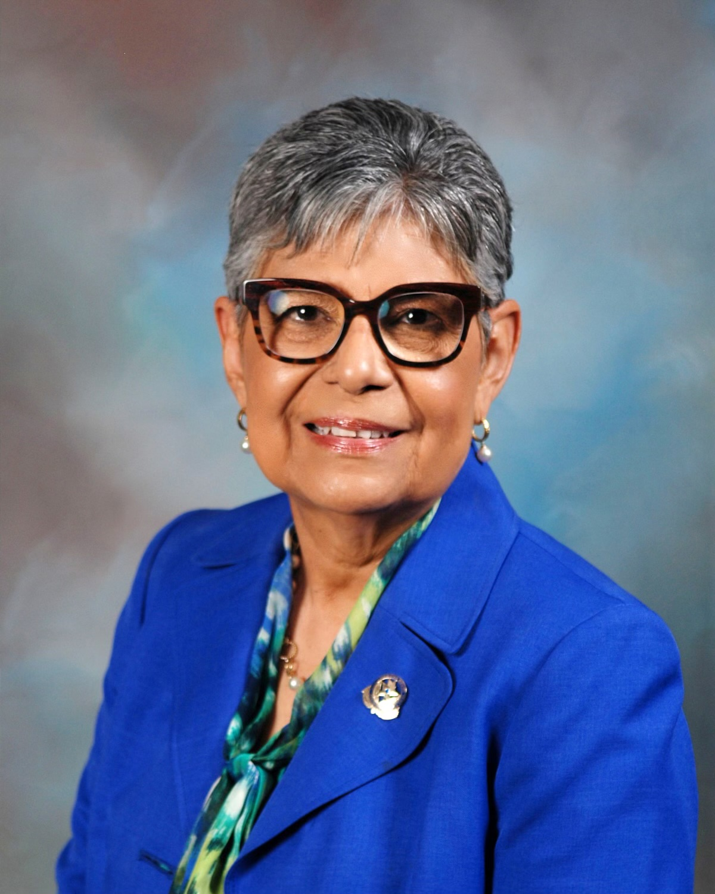
Submit Photos of State Officers
State Director: Rosa María Vida, PhD
1st Associate Director: Area C, Sandra Maxwell
2nd Associate Director: Area B, Marie Adams
\
3rd Associate Director: Area D, Sydney Goltz Burton
4th Associate Director: Area A, Judge Esmeralda Peña Garcia
Recording Secretary: Leticia “Letty” Ramon
Corresponding Secretary: Annie Ochoa
Treasurer: Bert Bas Blackburn
Historian: Ciara B. Perez
Parliamentarian: Ana P. Flores
Scholarship: Carmen Guerra
Immediate Past State Director: Margot S. Arévalo González

Slide 8
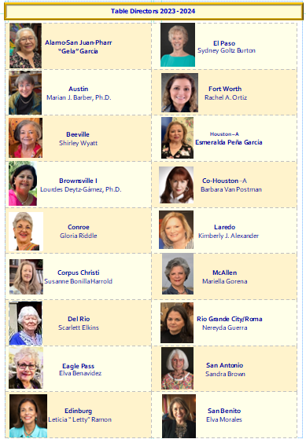
Submit
Photos of Table Directors

Slide 9
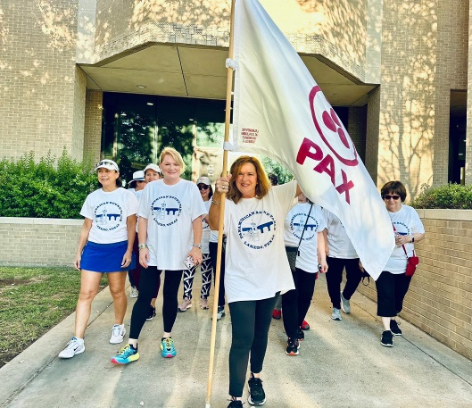
Give Suggestions on what to submit
Founders Day
Induction of New Members
Guest Speakers
Country Presentations, Current Events
Thanksgiving
Christmas
Observance Day
Scholarships
Charitable Events, Food Drives, Book Donations to local libraries, Environmental Education, Peace promotion, Celebrating the Day of the Young Child, International Women's Day, …
Election of Officers
And more

Slide 10
What if?
  Some Tables may not have any members who are computer literate and are unable to submit information.
  Ask them to send photos by mail with description

Slide 11
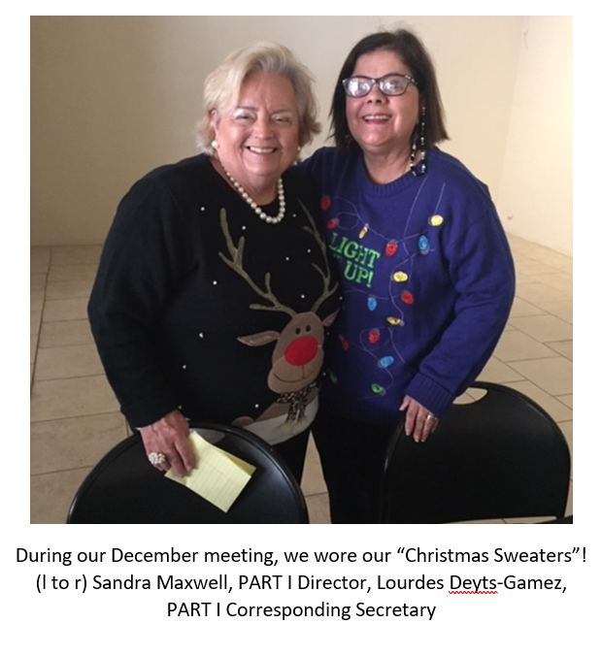
How to submit
Ask the Table member to attach a photo and description to an MS Word document or MS Publisher document.
Label: Table Name
Next to photo: Type Description
“The Laredo Table held our new member orientation during the July meeting. We wore traditional Mexican clothing and enjoyed a delicious meal.”
If submitting a photo, be sure it is labeled with the Table name.

Slide 12
Contact Information
Email: roliva39@gmail.com
Phone: 956-515-6489
3900 Neuhaus Drive, McAllen, TX 78503

